Slide 1

Home
About
Our Team Synopsis PPT
I am here to help you
AI
ChatBot

Slide 2



Our team
Abhay Kushwaha
Akshay Jain
Abhinav Gupta
B.Tech 2nd year
2202900100006
B.Tech 2nd year
2202900100009
B.Tech 2nd year
2202900100021

Slide 3
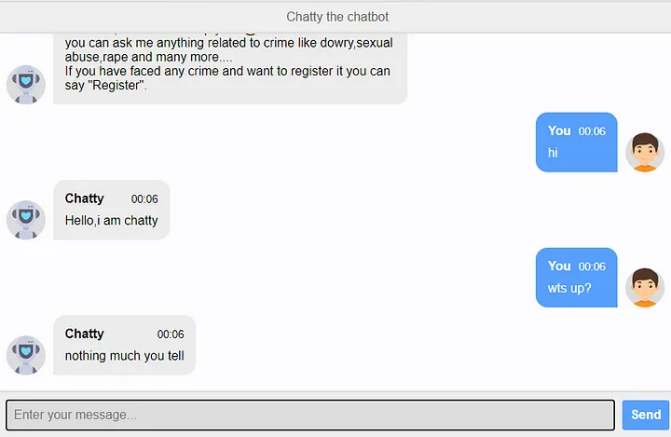
Introduction
A chatbot is a computer program that can converse with humans using AI in messaging platforms. Every time the chatbot gets input from the user it saves input and response which helps the chatbot with little initial knowledge to evolve using gathered responses.
The AI-powered chatbot, we are going to develop will be a text-based conversational agent capable of understanding and generating human-like responses. It can be integrated into websites, messaging platforms, or standalone 4 applications. This chatbot can be trained to provide information, answer frequently asked questions, or engage in casual conversation with users.

Slide 4
PROBLEM
It’s quite common for people to visit new sites daily and they might face problems navigate through the website, or if there is any registration process, they might get puzzled with various doubts. This is where our AI Chatbot will be a game changer.
The main motive is to create a chatbot that consistently offers accurate and helpful responses, continuously learning from interactions, and evolving to be a reliable resource for future projects.

Slide 5
SOLUTION
Our team is indulge in creating a ChatBot that consistently offers accurate and helpful responses, continuously learning from interactions, and evolving to be a reliable resource for future projects.
A Chatbot allows a user to simply ask questions in the same manner that they would address a human.

Slide 6
Types Of ChatBot
Generative ChatBot
The next gen chatbots with generative AI capabilities that offers even more enhanced functionality through their fluency in understanding common language
Rule Based ChatBot
The rules-based chatbot employs conditional if/then logic to act on predefined combinations of question-and-answer options.
AI Powered ChatBot
With AI and natural language understanding (NLU) capabilities, the AI bot can quickly detect all relevant contextual information shared

Slide 7
Features of AI-ChatBot
Enhanced User Experience
24/7 Availability
Efficient Customer Support
Scalability
Cost Effective
Integration With Platform

Slide 8
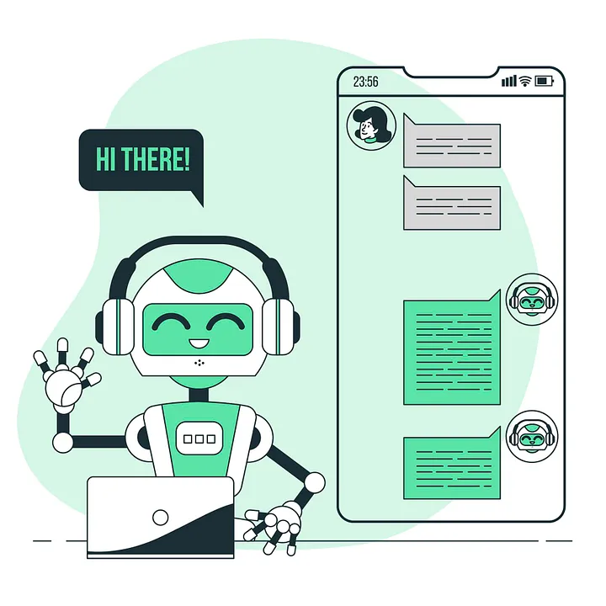
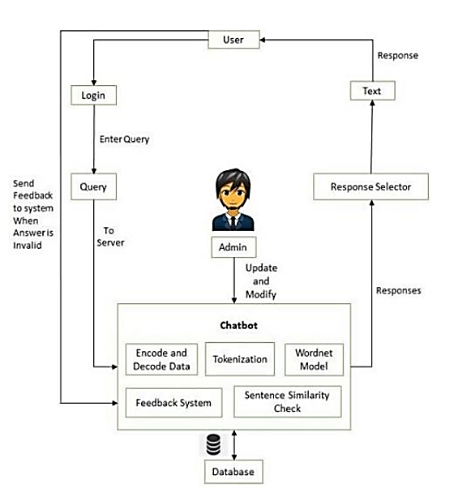
Flow Chart

Slide 9
Acceptance Of AI ChatBot
By Customers and Industries

Slide 10
WorkFlow
Step 1
Step 3
Input from a user
Identify Intents and entities
Step 2
Step 4
Analyze User’s request
Compose Reply

Slide 11

Tech-Stacks
Python
Base Language
Django
Python Web framework
wolframalpha
API to answer factual queries
Wikipedia
Library for interaction with Wikipedia
AI ChatBot
Webbrowser
Module for Automated Web interaction
SQLite3
Database
HTML, CSS, JS
Frontend

Slide 12
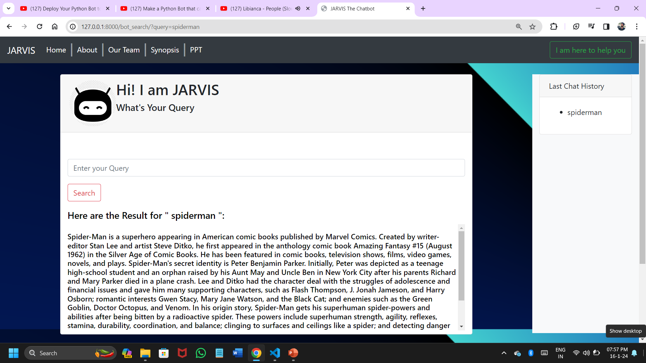
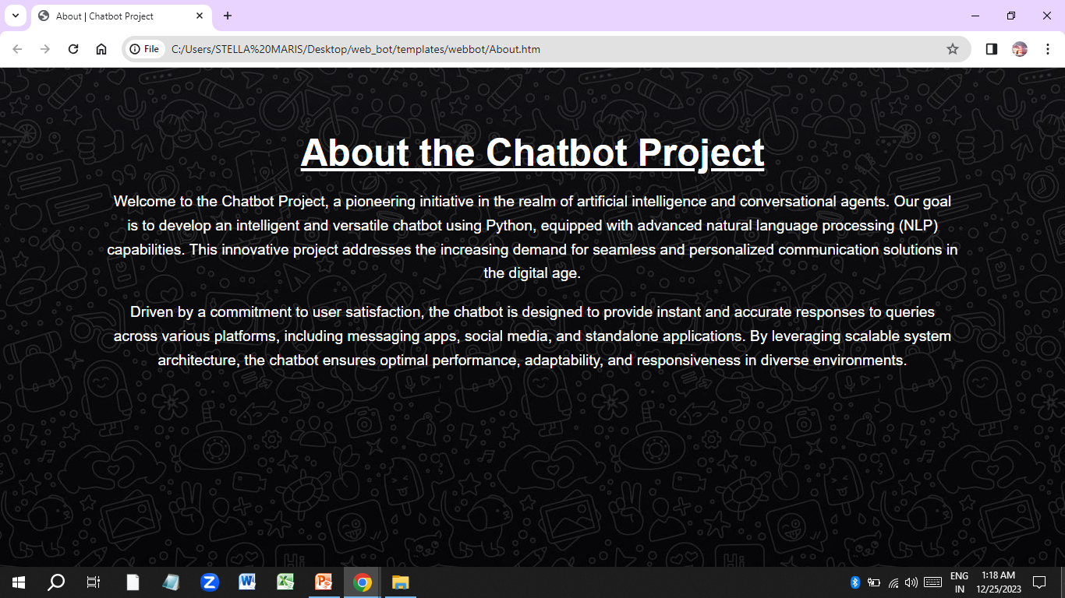
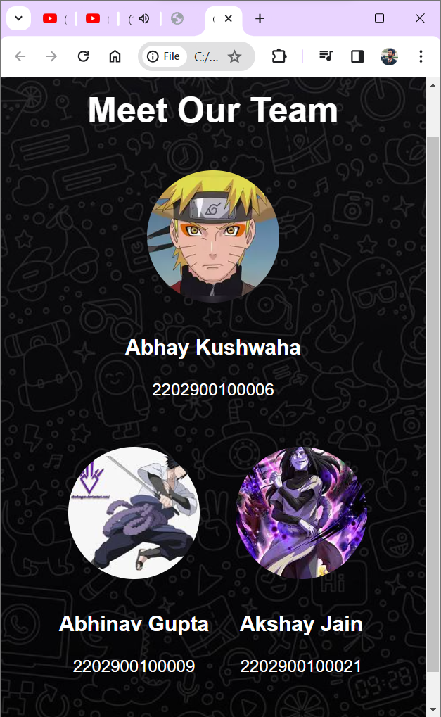
Implementation
Home Page
About Page

Slide 13
Thanks!
Any Query ??

